Slide 1
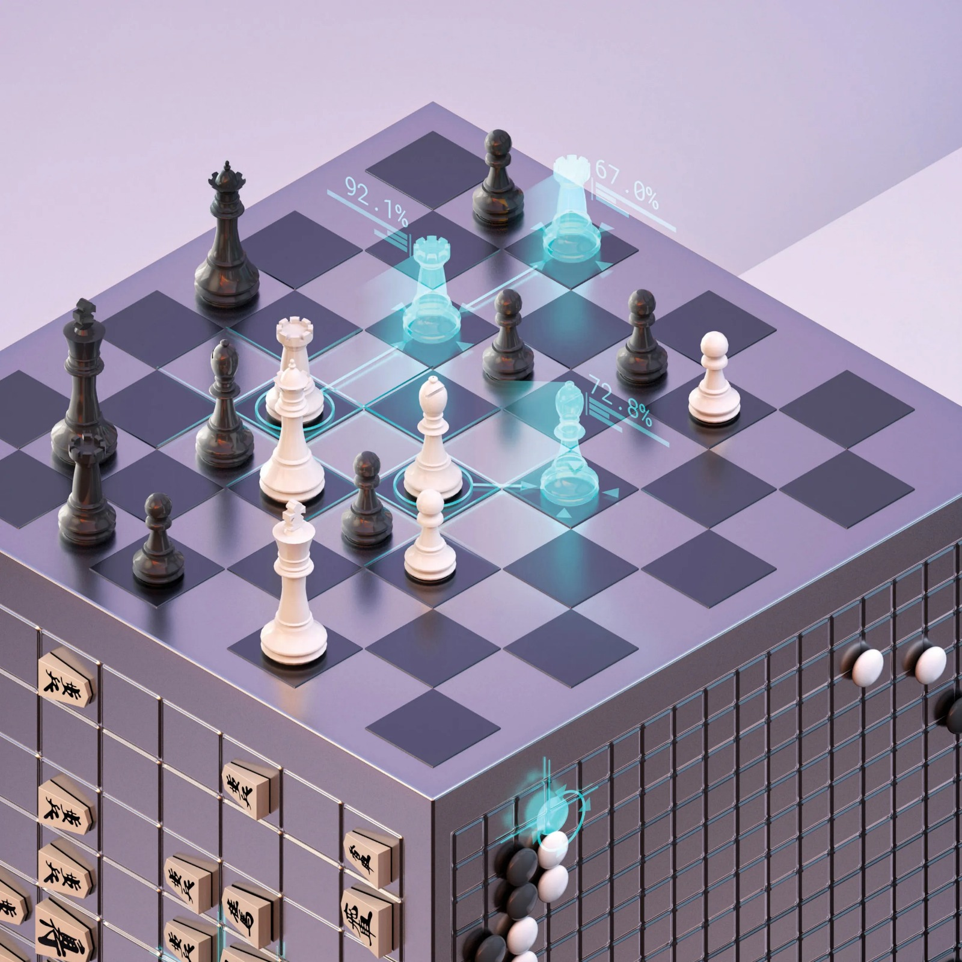

Slide 2

Deepmind
Based in London
Founded in 2010
Develop AI for video games and board games
Created Projects like:
Neural Turing machine
Alpha Go

Slide 3
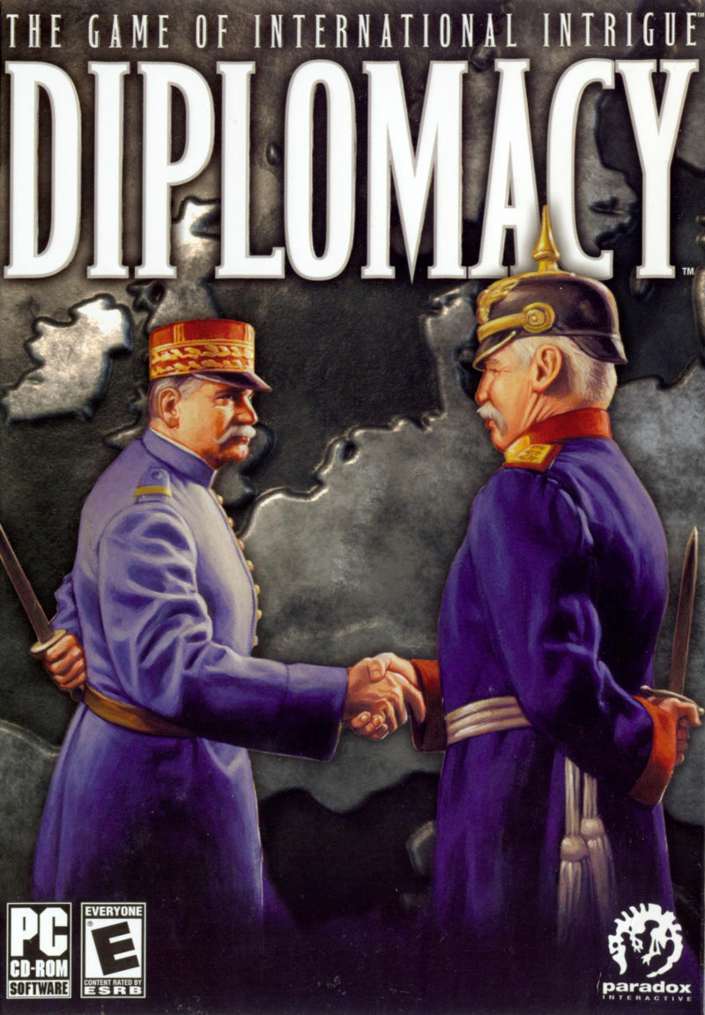
Diplomacy
Created in 1954
By Allan B. Calhamer
Depicts years leading to the Great War
Hold enough important cities to win

Slide 4
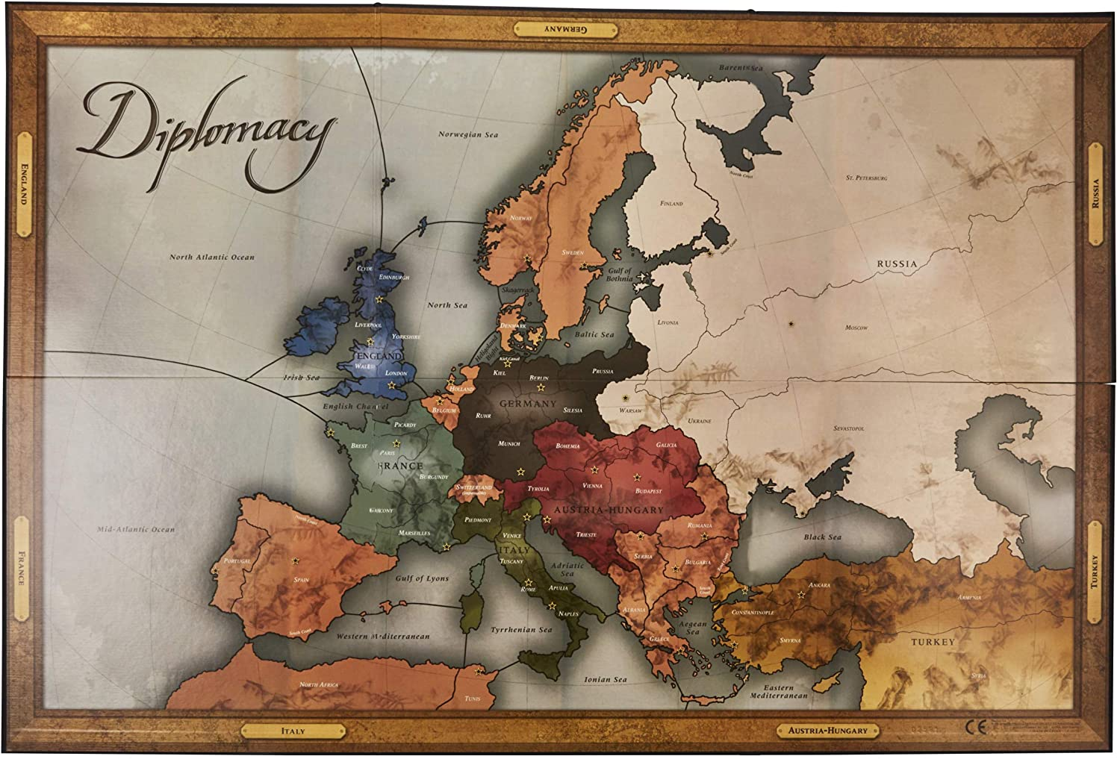
Teaching the AI
Sampled Best Response (SBR)
Evaluation
Head to head
Winrate vs. Population
Policy Transitivity

Slide 5
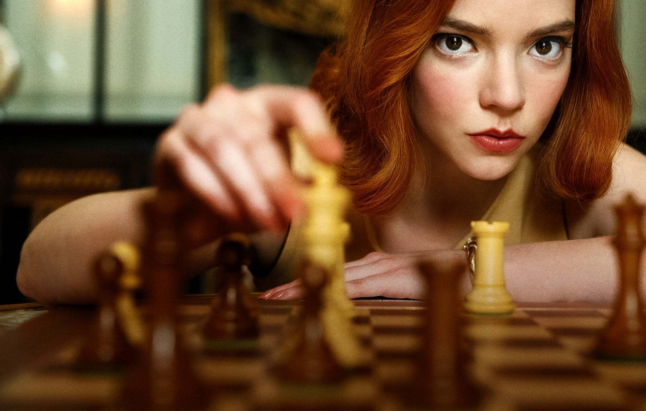
Chess
Chess has gained tremendous popularity, and it is leading to a revolutionary trend due to more people getting involved with chess at the time of this global pandemic. So, there is no better time to analyze the role of artificial intelligence in improving the quality of chess.
Artificial Intelligence is a revolution in itself with the numerous feats of accomplishments that it has been able to achieve. The use of AI in the real world and real-life scenarios is ample. They have a wide array of use cases to improve the quality of life in general. Another wonderful use of Artificial Intelligence is in the sport of Chess.
From the Netflix Show : The Queen’s Gambit

Slide 6
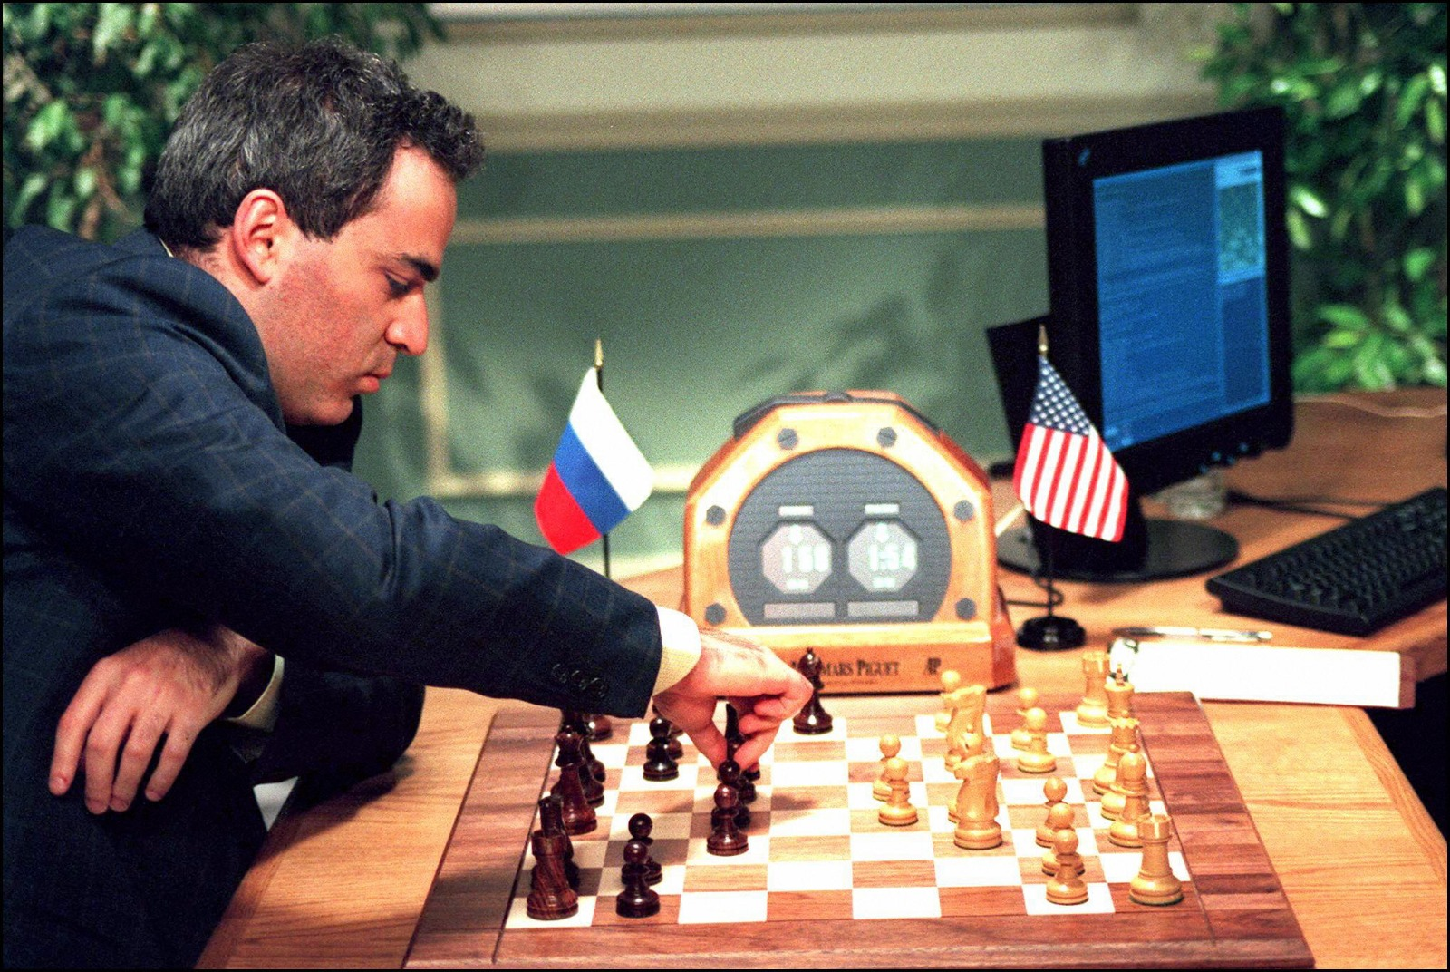
The Rise of Chess AIs
In 1951, Alan Turing was the first to publish a program, developed on paper, that was capable of playing a full game of chess. Consistent developments were continued to be made in the upcoming years. New chess games and chess engines were developed during this period. However, success on a higher level was yet to be achieved for these AI chess engines. Possibly, due to the lack of effective resources and tools.
1997 is considered to be the year of a major breakthrough and progress in the field of computer science when IBM's program “Deep Blue” beat Garry Kasparov, the world chess champion at the time. Although there is a small controversy regarding the authority of this win, it is mostly regarded in the favour of the chess engine. Today, Chess engines have come a long way from the era of the 1950s to the current generation of chess games.
Garry Kasparov playing against IBM’s Deep Blue

Slide 7
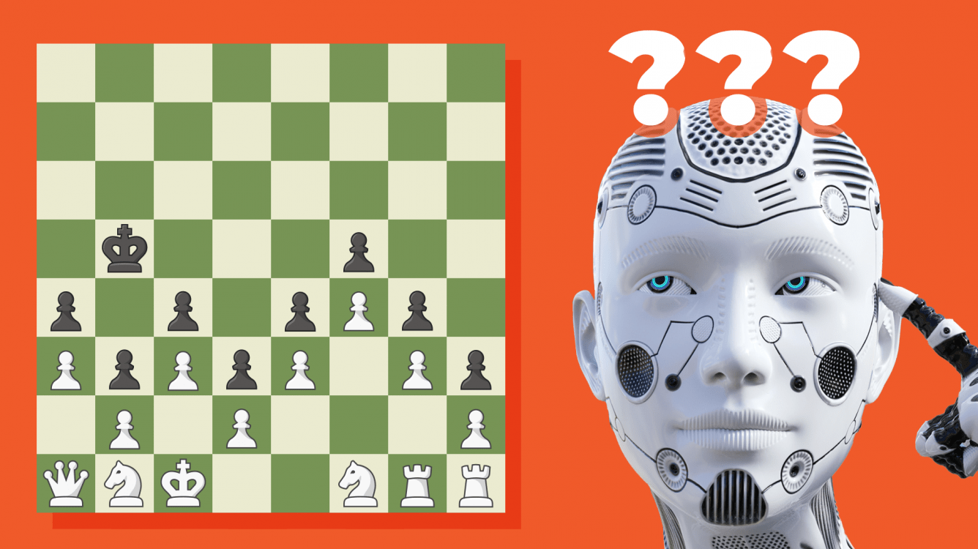
Modern Chess Engines
Nowadays, modern chess engines are so well-developed that they will not drop a single game to human players. Even the current reigning, defending world champion, Magnus Carlsen would fail to beat the modern best chess engine even once in a span of 100 games. Magnus Carlsen has a FIDE rating of over 2800 across all formats. To draw a picture, Stockfish 9, at the time Magnus was crowned world champion, had a rating of over 3400. Stockfish 8 was considered the strongest chess engine, which for most top players is their go-to preparation tool, and which won the 2016 TCEC Championship and the 2017 Chess.com Computer Chess Championship.
Stockfish 8 at the time used the technology of Brute force to compute and calculate 70 million chess positions per second. Of these millions of moves, Stockfish picked what it saw as the very best one, with “best” defined by a complex, hand-tuned algorithm co-designed by computer scientists and chess grandmasters. That algorithm valued a delicate balance of factors like pawn positions and the safety of its king.
Chess Engines

Slide 8
Google’s Deepmind : AlphaZero
But in late 2017 everything changed. The DeepMind team at Google introduced the AI AlphaZero. They gave it four hours and the basic rules of chess. After only four hours of training, DeepMind estimated AlphaZero was playing chess at a higher Elo rating than Stockfish 8; after nine hours of training, the algorithm defeated Stockfish 8 in a time-controlled 100-game tournament (28 wins, 0 losses, and 72 draws). AlphaZero in some ways was very much weaker than Stockfish—powering through just 1/100th as many moves per second as its opponent.
But AlphaZero is an entirely different machine. Instead of deducing the “best” moves with an algorithm designed by outside experts, it learns strategy by itself through an artificial intelligence technique called machine learning. Its programmers merely tuned it with the basic rules of chess and allowed it to play several million games against itself. As it learned, AlphaZero gradually pieced together its own strategy. It combined a neural network and Monte Carlo Tree Search in an elegant policy iteration framework to achieve stable learning.

Slide 9
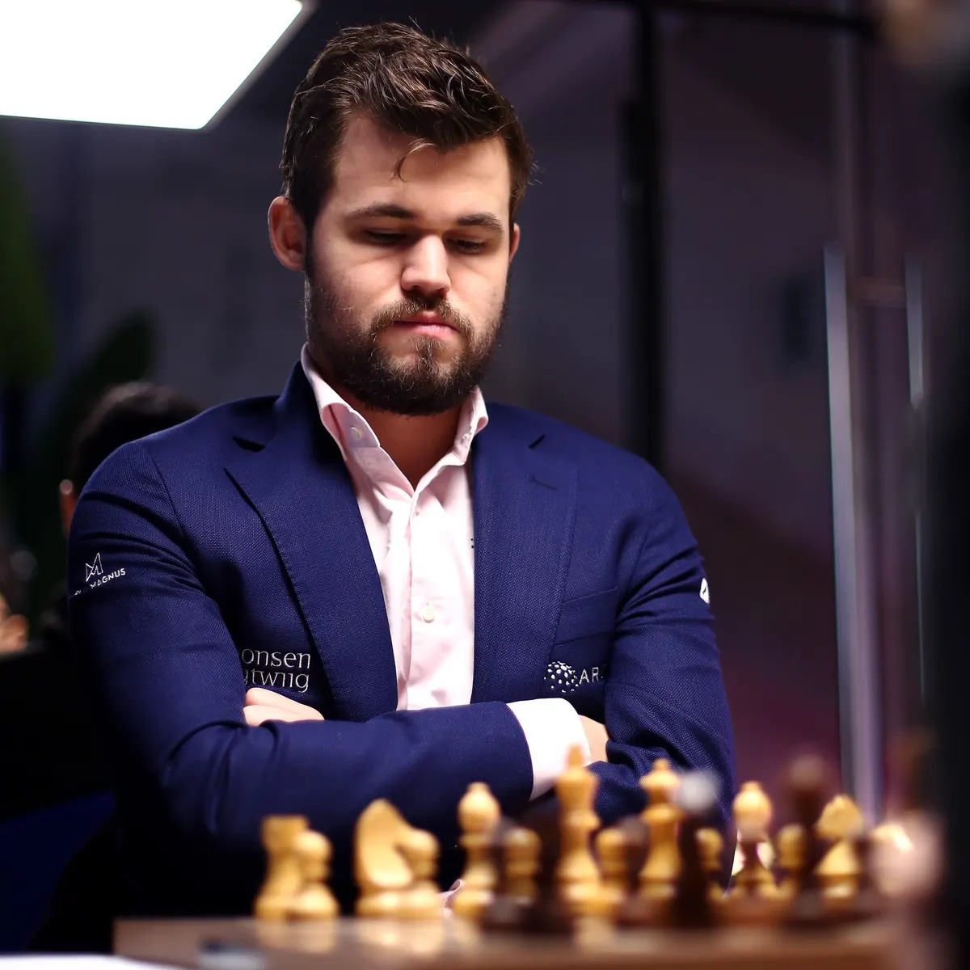
An Even Greater Future for Chess and AI
These modern results with the help of chess engines and neural networks and deep learning-based chess networks taking over the chess world by storm is a huge sign of the potential for greater and enormous possibilities.
Current World Chess Champion Magnus Carlsen

Slide 10
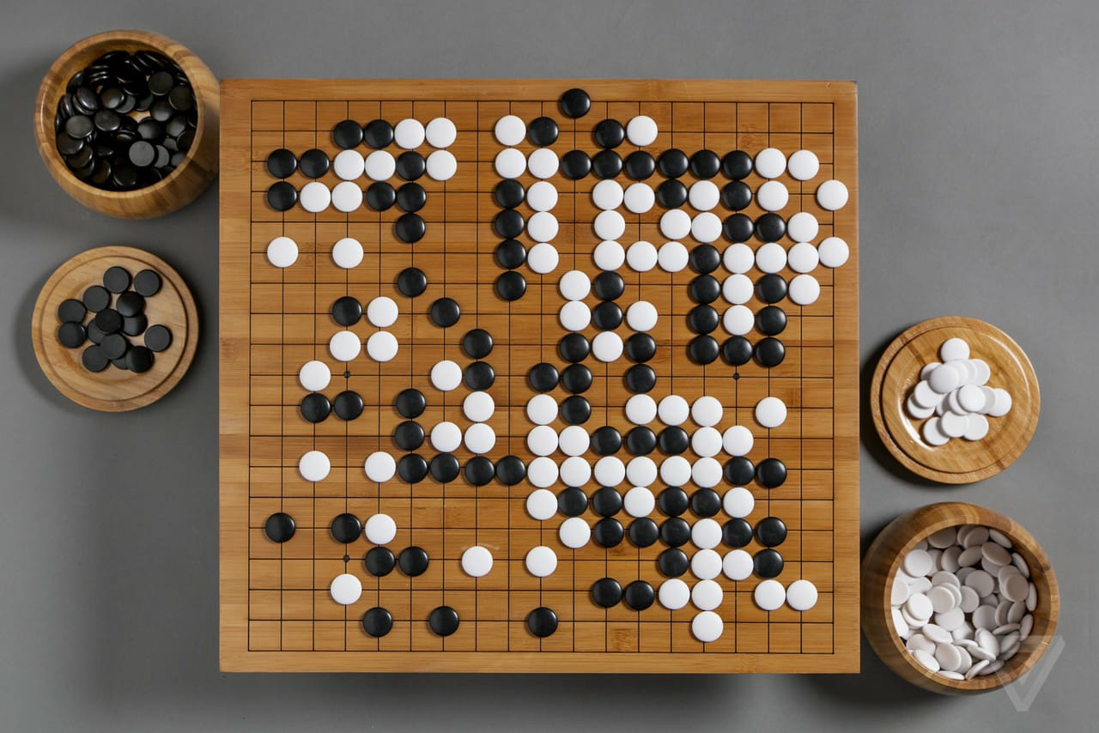
Go
Go, or Weiqi is an abstract strategy board game for 2 players in which the aim is to surround more territory than the other opponent. The game was invented in China nearly 2500 years ago and is believed to be the oldest board game continuously played to the present day. The game of Go although at a first glance seems simple enough with black and white stones of uniform type, but as we slowly take a deeper dive into the strategies and tactics involved within the game, we find out that the game is far more complex. In the field of Artificial Intelligence, computer-generated gameplay suggests how brains operate. Spearheaded by Demis Hassabis, David Silver, and their colleagues at the artificial intelligence (AI) company Google DeepMind, the team actively worked on a computational strategical program called AlphaGo, that used a combination of brute force logic and tree search, and in the later versions, self-learning, that made AlphaGo the strongest engine at the game of Go that defeated all the best Go players in the world Including the World Champion.

Slide 11
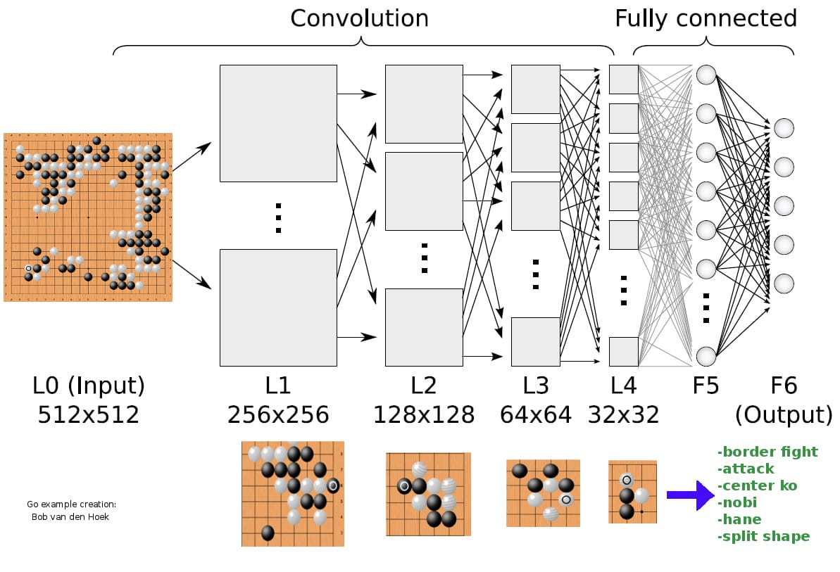
Deepmind, AI and Go!
To understand the power of this approach in playing board games, consider the search spaces involved. The “game tree complexity” of tic-tac-toe—i.e., an estimate of the number of possible positions that must be evaluated to determine the worth of an initial position—is about 2 × 104.There are several different ways to measure the complexity of more difficult board games, leading to different estimates. But no matter the method used, as the complexity of board games grows, the relevant search spaces become unimaginably large. The game tree complexity is estimated to be about 1020 for checkers, about 10120 for chess, and an astonishing 10320 for Go (6).
For comparison, the estimated number of atoms in the universe is on the order of 1087. Unlike tic-tac-toe, fully searching spaces of this magnitude is not feasible. In the strategy used by Google DeepMind, success follows not from a logical exploration of possible moves but from the instantiation of trial-and-error play in the network’s connectivity that beats a competing machine playing in the same empirical way.The relevance of AlphaZero to neuroscience is the size of the search spaces organisms—and ultimately animals with brains—must contend with as they play “the game of life” by making “moves” that are rewarded by survival and reproductive success. Although the complexity of this biological “game tree” for humans is beyond reckoning, it dwarfs the complexity of board games such as Go.

Slide 12
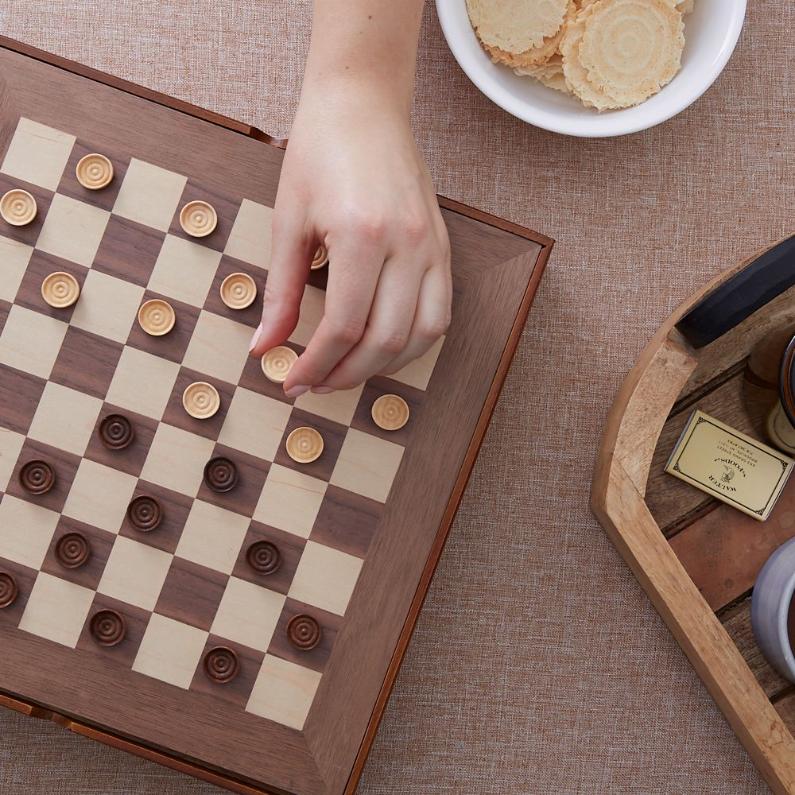
Checkers
Checkers, also known as Draughts, is a 2 player strategy board game. The aim is to be the first to take all your opponents pieces by moving diagonally on a 8 x 8 checkered board. The game is known to be more than 5,000 years old and has origins in Iraq as far back as 3,000 BC. There are 2 versions of Checkers that are known. There is the standard American Checkers, which is played on a 8 x 8 board and consists of the pieces moving forward only. Another version is Russian Checkers, which is played on a 12 x 12 board, and International Checkers, which features a 10 x 10 board. These games usually last for anywhere between 5 minutes to 30 minutes. For convenience, I will only speak of the most well known version of Checkers, which is American Checkers.
A few of the basic rules for Checkers, for example movement. You may only move your piece in a diagonal way and can only take your opponents piece, if you ‘jump’ over them.

Slide 13
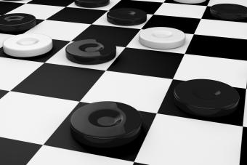
Humble Beginnings
Like Chess, Checkers is played on a N x N board. This means that is can be played on a board of any size without there being any ambiguity of any kind between players.
The man behind the Checkers engine is Jonathan Schaffeur, and his opponent was Marion Tinsley, a maths professer, minister and finally, the master of Checkers. Tinsley was the best player in the game for the better part of 40 years. He had only lost a handful of games to people in his career, but not a competitive game. His opponent, Chinook, developed by Schaffeur was unbeaten in 125 games before facing Tinsley. After 6 games, all being draws, Tinsley was sent to hospital where he discovered a lump on his pancreas. He was forced to retire and Chinook became the first Artificially Intellegent program to win at the human world championship. A program as a result of thousands of hours of tuning and research, to win at the world championship, due to its opponent discovering pancreatic cancer.

Slide 14
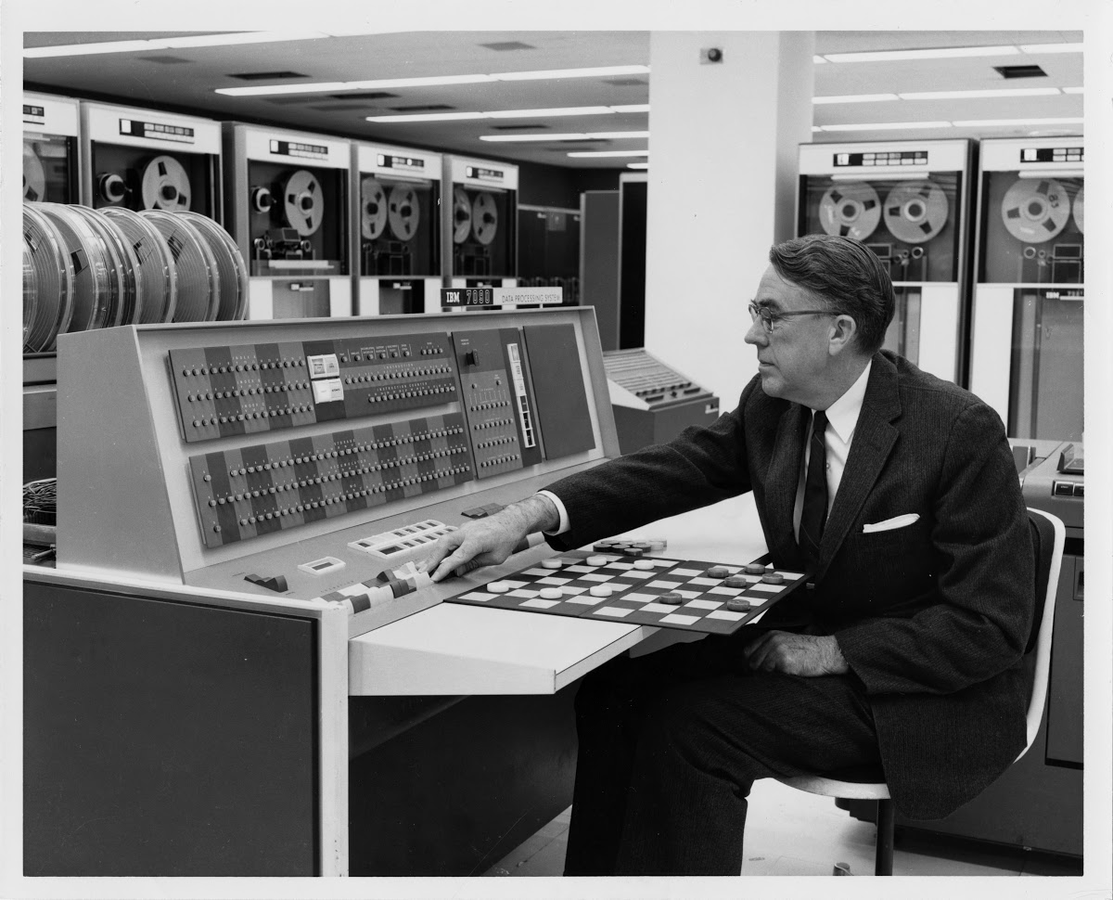
Where It Began
At the highest levels, checkers is a game of mental attrition. Most games are draws. In serious matches, players don’t begin with the standard initial starting position. Instead, a three-move opening is drawn from a stack of approved beginnings, which give some tiny advantage to one or the other player. They play that out, then switch colours. The primary way to lose is to make a mistake that your opponent can jump on.
The first checkers program was developed in the 1950’s by an IBM employee named Arthur Samuel. He originally intended for his program to run on an IBM 704. He spent a good 15 years on this idea and at the end had published some well known papers, some of which include the concept of machine learning.

Slide 15
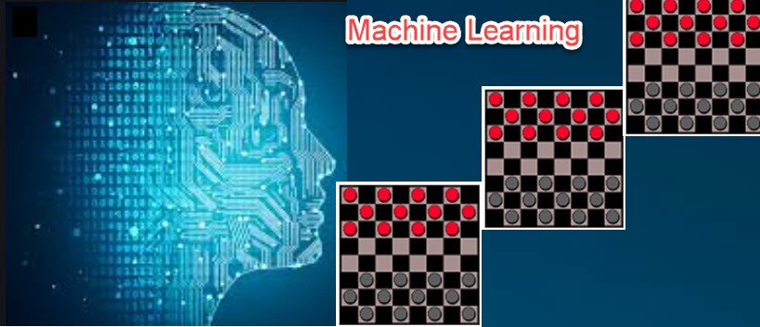
Machine Learning
Machine learning is one of the most modern forms of Artificial Intelligence. It is the basis for the likes of Algorithms and Perception. Samuel’s program was never very successful and was famously known for being trounced by the Endicott Johnson club in 1958. But it was important in the grand scheme of Machine Learning for Checkers. Samuel also quoted in on of his papers “The human brain, sometimes lost sight of in an age of satellites, frozen foods, and electronic data processing machines, returned to former glories early today,”
Chinook needed to search through possible moves beginning with the start of a match. Like many similar systems, Chinook would look ahead many possible moves and then try to score each permutation’s desirability. At first, Chinook could only look ahead 14 to 15 moves out, but as computers and the software improved, it could look further and further. “As with chess, deeper was always better,” Schaeffer said.

